Slide 1
Sirius USB Review
IP Owner: Hao Sun

Slide 2
USB3.0 DRD
Introduction
Application
Controller config
Controller and PHY integration
Local sim env
Soc sim env
Pad Bump
ATE test
Bring up

Slide 3
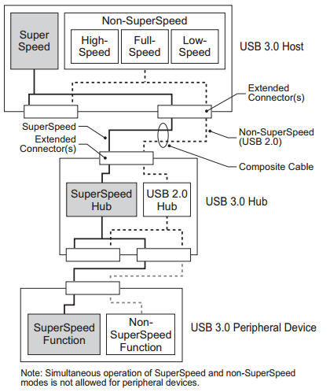
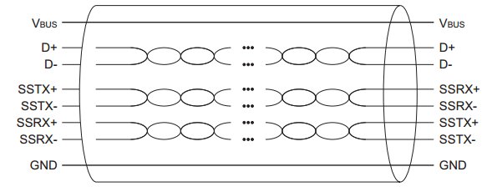
Introduction

Slide 4
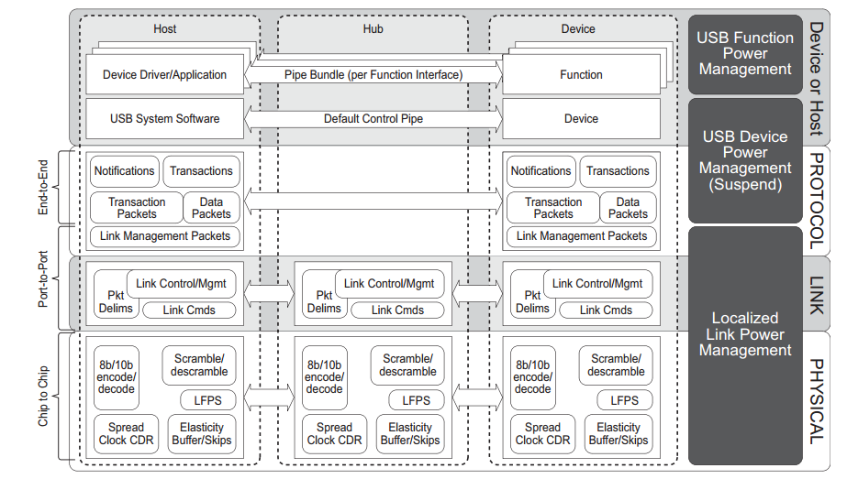
Introduction

Slide 5
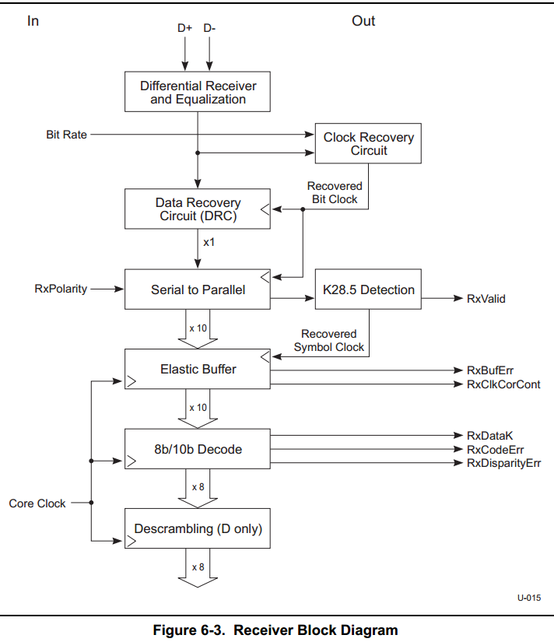
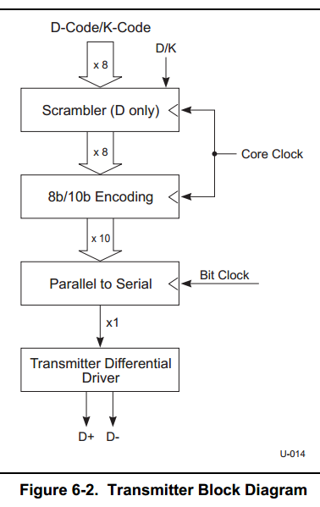
Introduction Physical

Slide 6
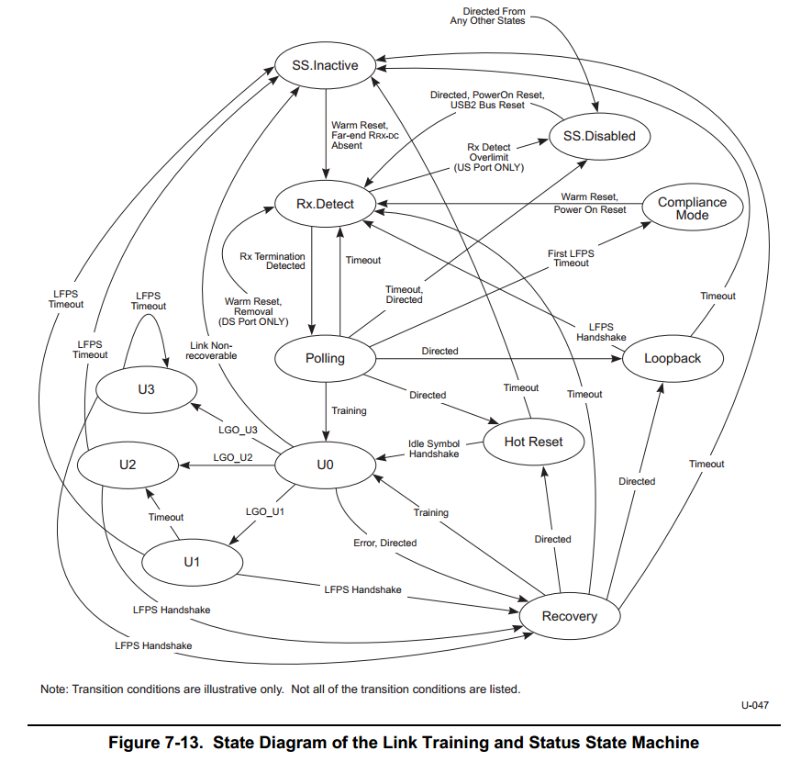
Introduction Link

Slide 7
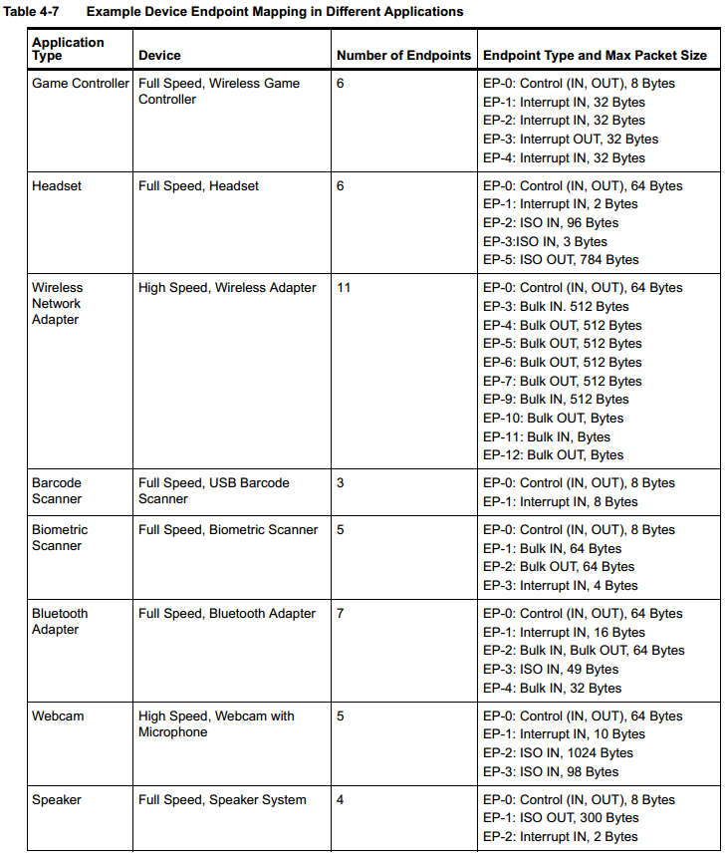
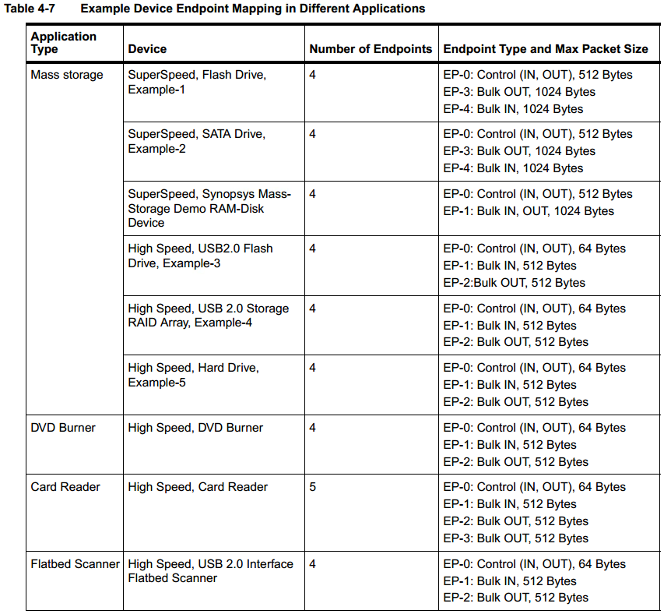
Application

Slide 8
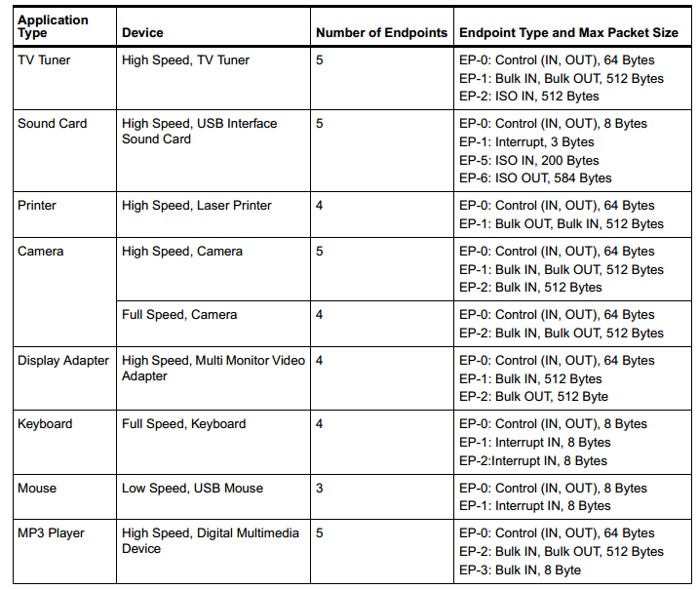
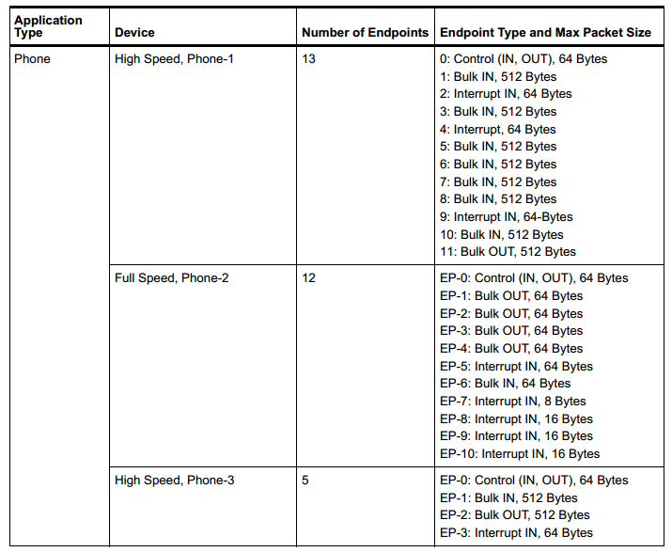
Application

Slide 9
Controller config
Dual-Role Device
Support large DMA bus latency(larger than 2.1us for 1KB SS)
2.0 PHY: 8bit UTMI+
3.0 PHY: 32bit PIPE3
Device: Max 16 endpoints
Rx/Tx MaxPacket Size 1024 Byte
Host: USB2.0/USB3.0 root hub ports 1
Support max 64 device
Support max 32 periodic endpoint

Slide 10
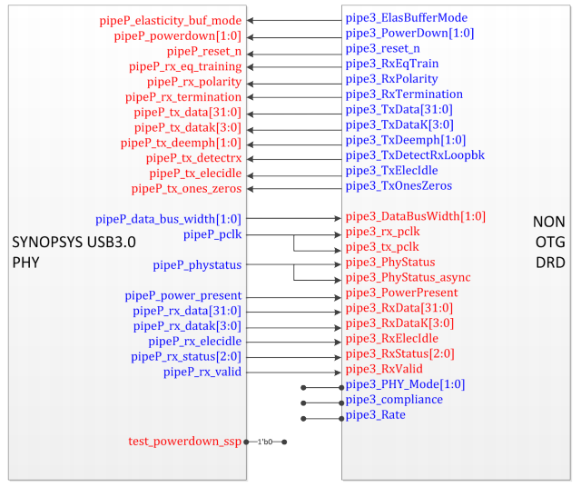
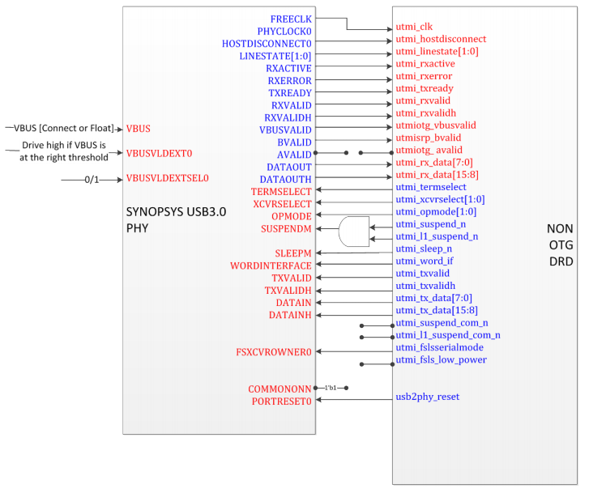
Controller and PHY integration

Slide 11
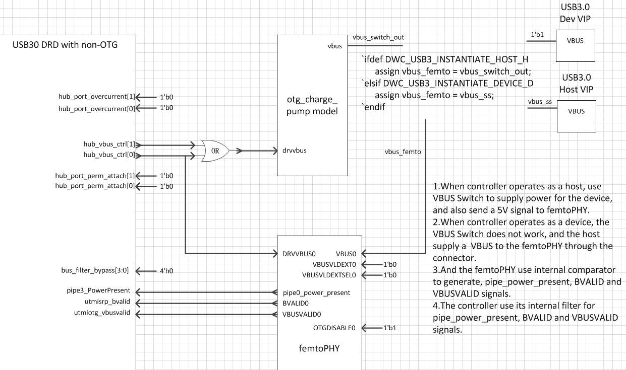
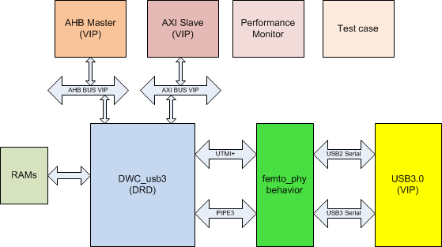
Local sim env

Slide 12
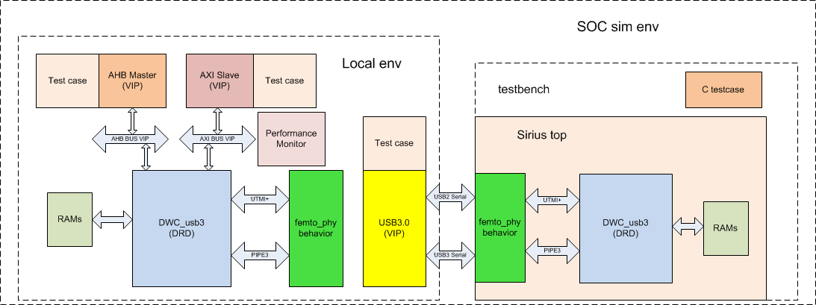
Soc sim env

Slide 13
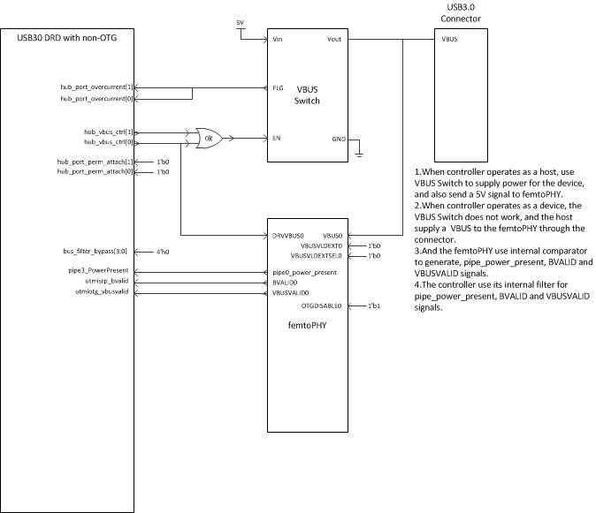
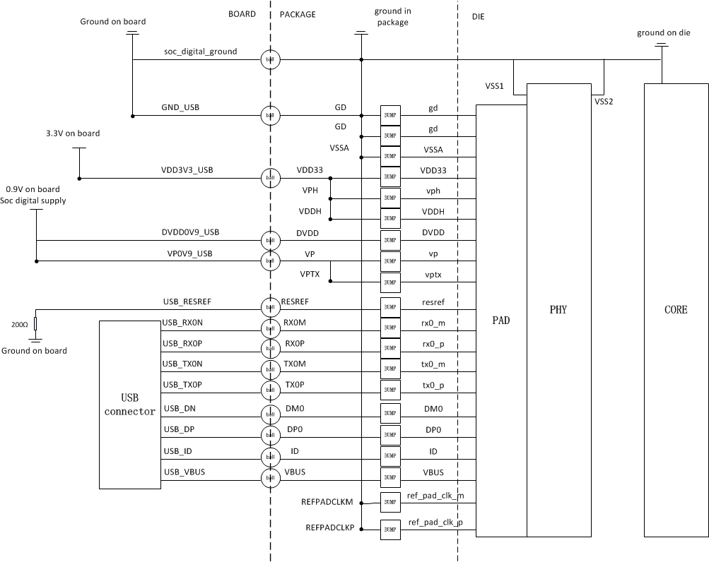
Package & board

Slide 14
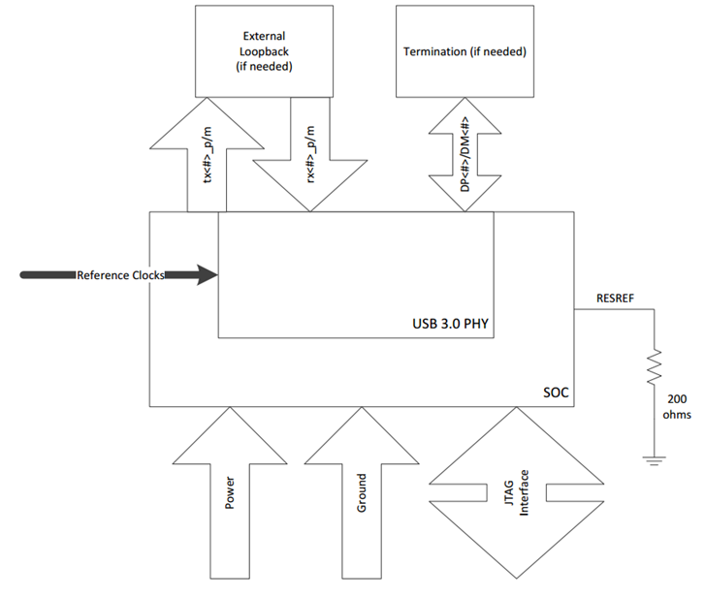
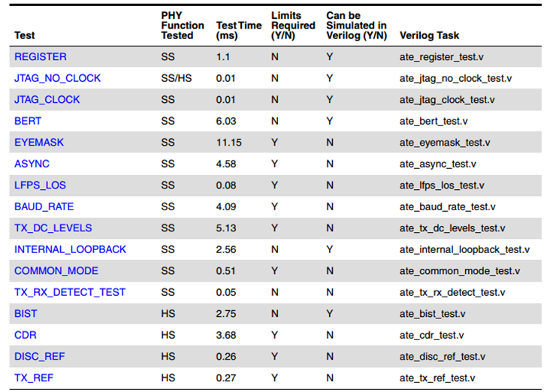
ATE test

Slide 15
Bring up
PHY ATE test.
Controller register access.
Check clock through debug port.
USB 2.0 attach detect and enumeration.
USB 3.0 link training.
USB 3.0 enumeration.
USB 2.0&3.0 single endpoint ctrl transfer.
USB 2.0&3.0 single endpoint bulk transfer.
USB 2.0&3.0 single endpoint interrupt transfer.
USB 2.0&3.0 single endpoint iso transfer.
USB 2.0&3.0 multi endpoint ctrl transfer.
USB 2.0&3.0 multi endpoint bulk transfer.
USB 2.0&3.0 multi endpoint interrupt transfer.
USB 2.0&3.0 multi endpoint iso transfer.

Slide 16
Thank You

